Slide 1
SECTION 5.5
Inverse Trigonometric
Functions and Their Graphs
Inverse sine • Inverse cosine • Inverse tangent • Inverse secant, cosecant, cotangent
Precalculus – Trigonometric Functions: Unit Circle Approach

Slide 2
BIG IDEA
Why Do We Need Inverse Trig Functions?
The problem
For a function to have an inverse, it must be one-to-one. The trig functions are NOT one-to-one over their full domain — infinitely many x-values share the same sine, cosine, or tangent value.
The fix
Restrict the domain to an interval where the function is one-to-one AND still attains every value in its range. Each restricted trig function then has a genuine inverse.
y = sin x
1
[−π/2, π/2]
restricted domain:
y = cos x
2
[0, π]
restricted domain:
y = tan x
3
(−π/2, π/2)
restricted domain:
2

Slide 3
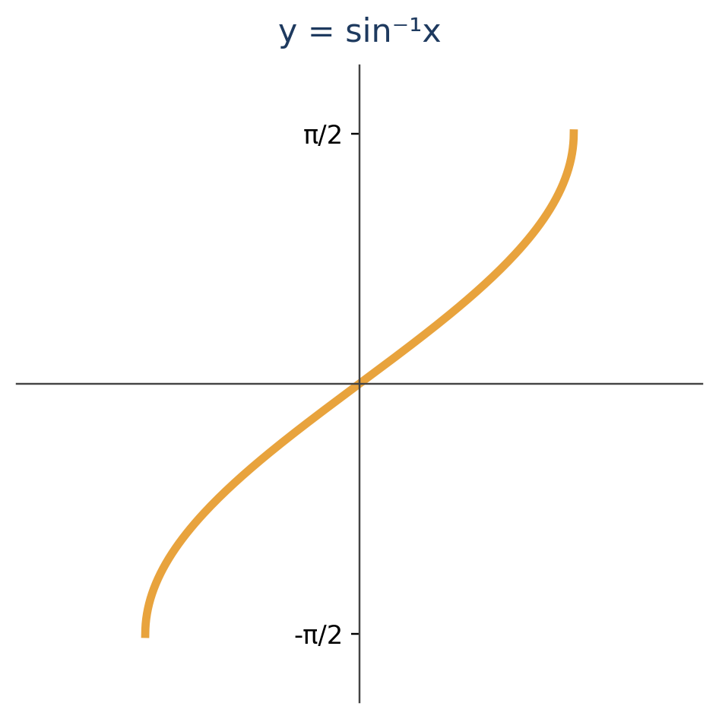
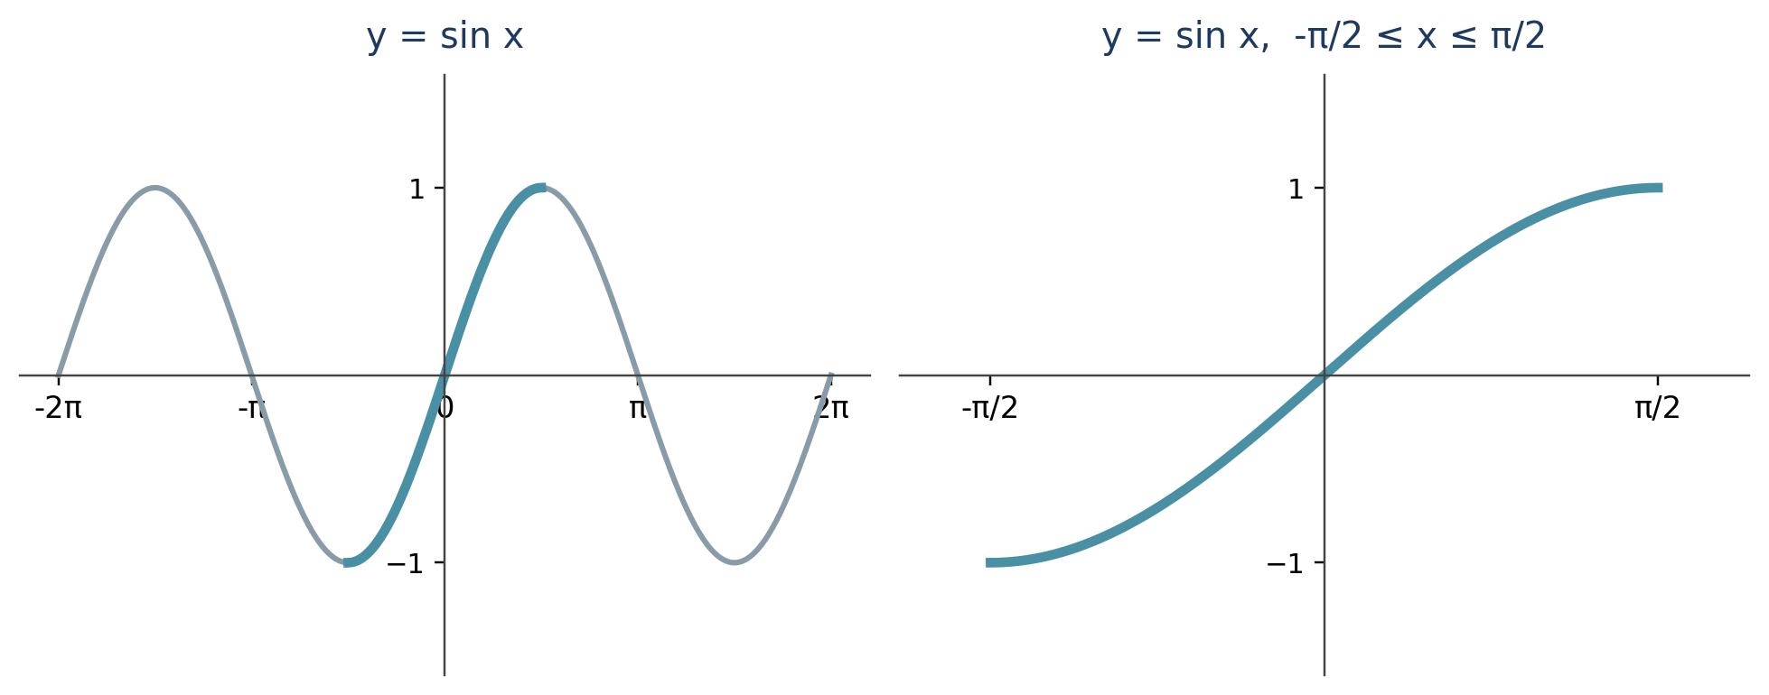
THE INVERSE SINE FUNCTION
Restrict, Reflect, Define
Reflecting y = sin x (on [−π/2, π/2]) across the line y = x produces the graph of y = sin⁻¹x.
Definition of the Inverse Sine Function
The inverse sine function sin⁻¹ has domain [−1, 1] and range [−π/2, π/2], defined by
sin⁻¹x = y ⇔ sin y = x
Also called arcsine, denoted arcsin.
3

Slide 4
THE INVERSE SINE FUNCTION
Cancellation Properties
sin(sin⁻¹x) = x
for −1 ≤ x ≤ 1
sin⁻¹(sin x) = x
for −π/2 ≤ x ≤ π/2
!
Watch the restriction
sin⁻¹(sin x) = x is only guaranteed when x is already in [−π/2, π/2].
If x falls outside that interval, you cannot cancel directly — you must first evaluate sin x, then apply sin⁻¹ to that number.
4

Slide 5
Ex 1
Evaluating the Inverse Sine Function
Find the exact value.
(a) sin⁻¹(¹⁄₂)
(b) sin⁻¹(⁻¹⁄₂)
(c) sin⁻¹(³⁄₂)
(a)
The number in [−π/2, π/2] whose sine is 1/2 is π/6.
sin⁻¹(¹⁄₂) = π/6
(b)
The number in [−π/2, π/2] whose sine is −1/2 is −π/6.
sin⁻¹(⁻¹⁄₂) = −π/6
(c)
Since 3/2 > 1, it is not in the domain of sin⁻¹x.
sin⁻¹(³⁄₂) is undefined
Key idea: sin⁻¹x asks “what angle in [−π/2, π/2] has this sine value?” — and any input outside [−1, 1] has no answer.
5

Slide 6
Ex 2
Using a Calculator to Evaluate Inverse Sine
Find approximate values. (Calculator in radian mode.)
(a)
(b)
sin⁻¹(0.82)
sin⁻¹(1/3)
≈ 0.96141
≈ 0.33984
Which calculator key?
Use the SIN⁻¹, INV SIN, or ARC SIN key(s) on your calculator, and double‑check it is set to radian mode before you evaluate.
6

Slide 7
Ex 3
Evaluating Expressions with Inverse Sine
Find the exact value. Remember: the range of sin⁻¹ is [−π/2, π/2].
(a) sin⁻¹(sin π/3)
(b) sin⁻¹(sin 2π/3)
π/3 is in [−π/2, π/2], so the cancellation property applies directly:
sin⁻¹(sin π/3) = π/3
2π/3 is NOT in [−π/2, π/2] — no direct cancellation. Evaluate inside first:
sin⁻¹(sin 2π/3) = sin⁻¹(√3/2) = π/3
Note
sin⁻¹(sin x) = x only if −π/2 ≤ x ≤ π/2. Outside that interval, evaluate step by step — never assume it cancels.
7

Slide 8
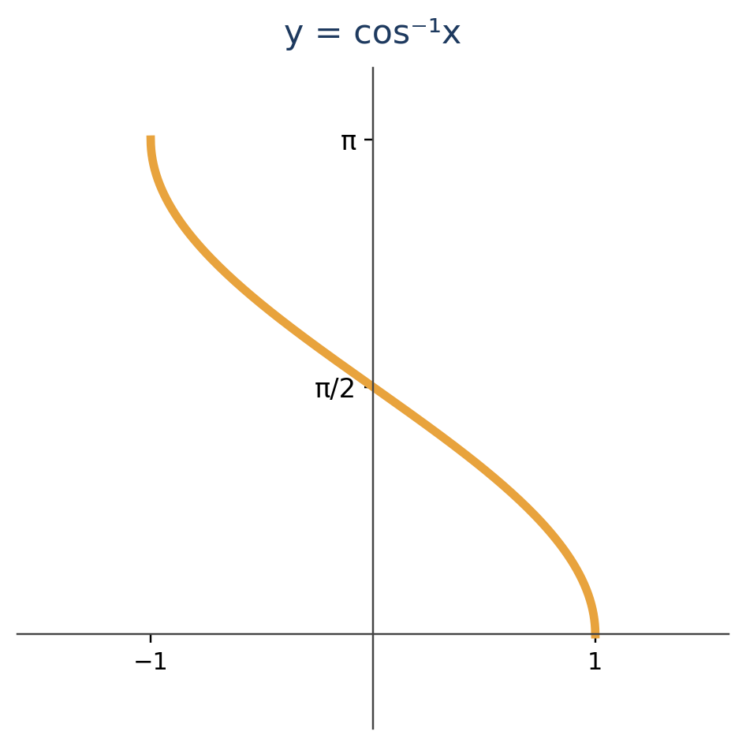
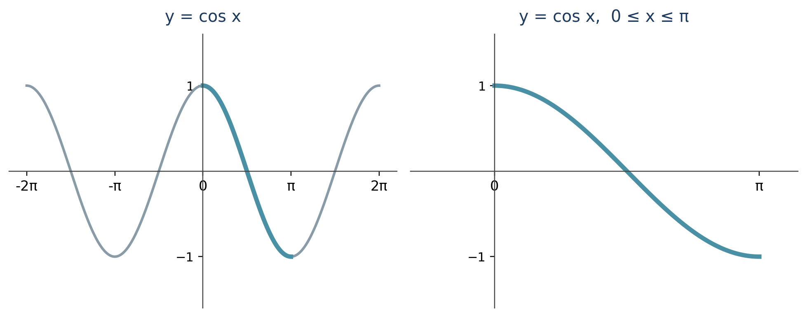
THE INVERSE COSINE FUNCTION
Restrict, Reflect, Define
Cosine is restricted to [0, π] because it is one‑to‑one there and attains every value in its range.
Definition of the Inverse Cosine Function
The inverse cosine function cos⁻¹ has domain [−1, 1] and range [0, π], defined by
cos⁻¹x = y ⇔ cos y = x
Also called arccosine, denoted arccos.
8

Slide 9
THE INVERSE COSINE FUNCTION
Cancellation Properties & Example 4
cos(cos⁻¹x) = x
for −1 ≤ x ≤ 1
cos⁻¹(cos x) = x
for 0 ≤ x ≤ π
Example 4 — Find the exact value
(a)
cos⁻¹(√3/2)
= π/6
cosine of π/6 is √3/2
(b)
cos⁻¹(0)
= π/2
Careful with negatives
cosine of π/2 is 0
If −1 ≤ x < 0, then cos⁻¹x > π/2. Part (c) above shows this: cos⁻¹(−1/2) = 2π/3, which is past π/2 — exactly what the graph of y = cos⁻¹x predicts.
(c)
cos⁻¹(−1/2)
= 2π/3
cosine of 2π/3 is −1/2
9

Slide 10
Ex 5
Evaluating Expressions Involving Inverse Cosine
Find the exact value. Remember: the range of cos⁻¹ is [0, π].
(a) cos⁻¹(cos 2π/3)
(b) cos⁻¹(cos 5π/3)
2π/3 is in [0, π], so the cancellation property applies directly:
cos⁻¹(cos 2π/3) = 2π/3
5π/3 is NOT in [0, π] — no direct cancellation. Evaluate inside first:
cos⁻¹(cos 5π/3) = cos⁻¹(1/2) = π/3
Note
cos⁻¹(cos x) = x only if 0 ≤ x ≤ π. This mirrors what we saw for sin⁻¹ — always check the interval before you cancel.
10

Slide 11
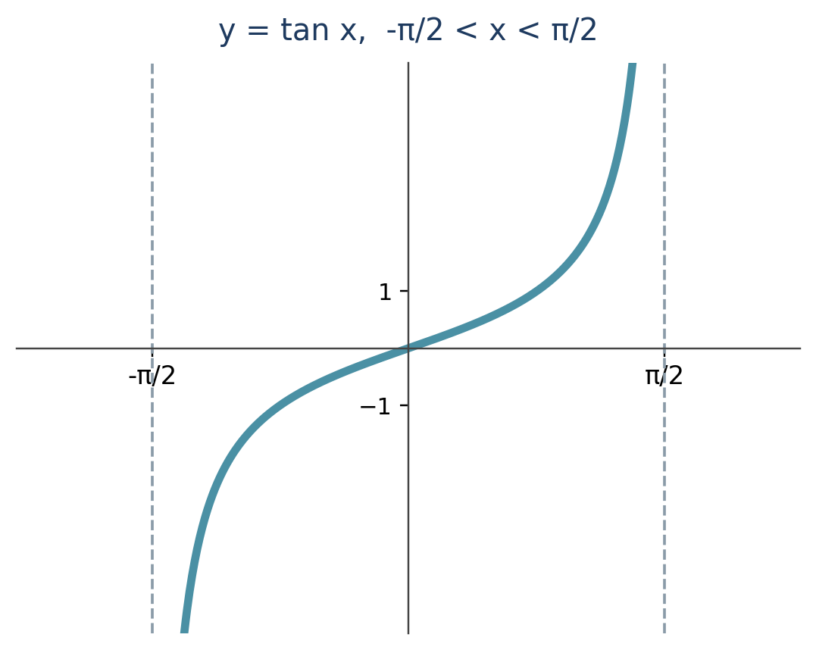
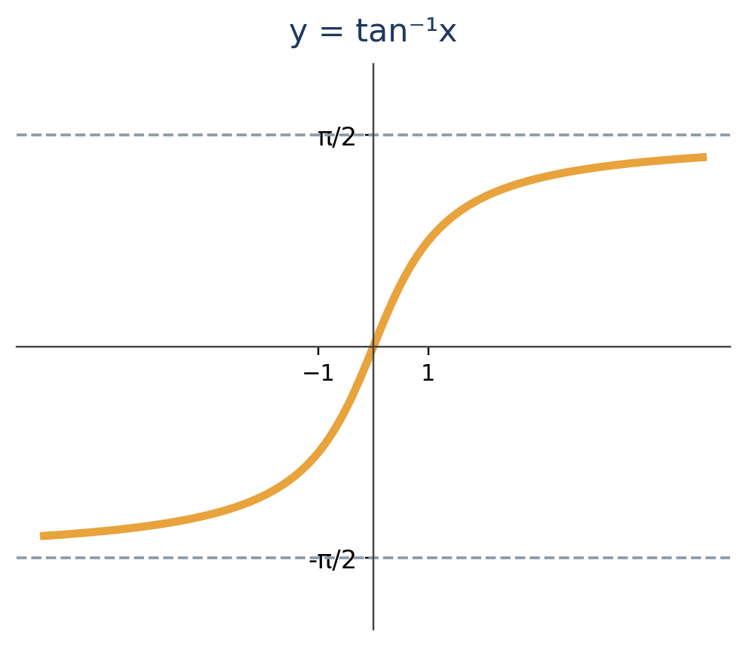
THE INVERSE TANGENT FUNCTION
Restrict, Reflect, Define
tan⁻¹x = y ⇔ tan y = x
Domain: all real numbers • Range: (−π/2, π/2) • Also called arctangent (arctan) • Horizontal asymptotes y = ±π/2
11

Slide 12
THE INVERSE TANGENT FUNCTION
Cancellation Properties & Example 6
tan(tan⁻¹x) = x
for all real x
tan⁻¹(tan x) = x
for −π/2 < x < π/2
Example 6 — Find each value
(a)
tan⁻¹(1)
= π/4
the angle in (−π/2, π/2) with tangent 1
(b)
tan⁻¹(−√3)
= −π/3
Notice the asymptotes
the angle in (−π/2, π/2) with tangent −√3
Because the domain of tan⁻¹ is all real numbers but the range is squeezed into (−π/2, π/2), the graph flattens out and never reaches y = ±π/2 — even for huge inputs like tan⁻¹(20).
(c)
tan⁻¹(20)
≈ 1.52084
use a calculator, radian mode
12

Slide 13
Ex 7
Composing Trig Functions and Their Inverses
Write cos(tan⁻¹x) as an algebraic expression in x.
1
Let u = tan⁻¹x.
We need cos u in terms of the tangent function.
2
Use reciprocal & Pythagorean identities.
cos u = 1/sec u = 1 / (±√(1 + tan²u))
3
Choose the sign.
Since u is in [−π/2, π/2], cos u ≥ 0 — so the “+” sign is correct.
4
Substitute back and cancel.
u = tan⁻¹x, and tan(tan⁻¹x) = x, so:
Result
cos(tan⁻¹x) = 1 / √(1 + x²)
13

Slide 14
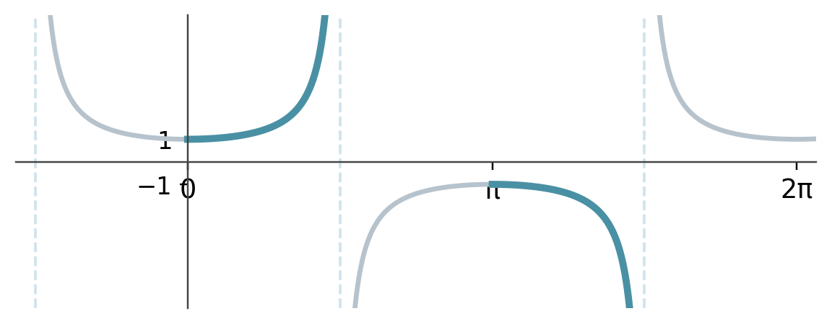
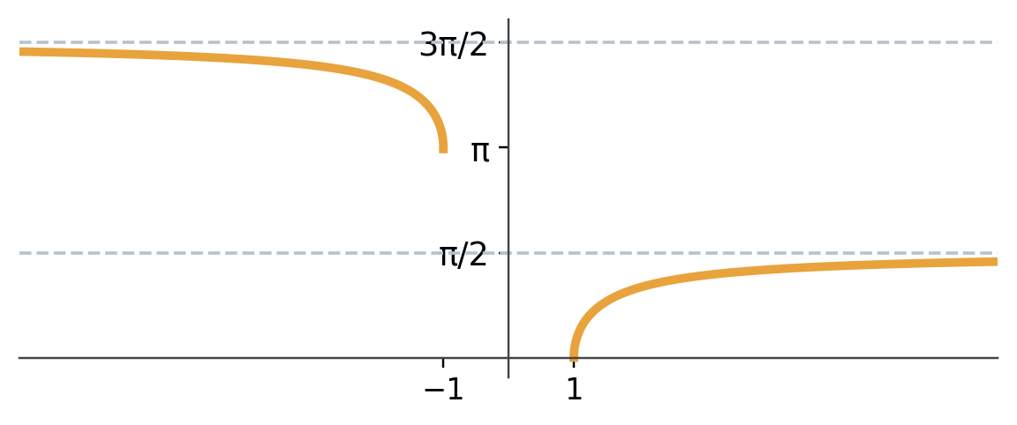
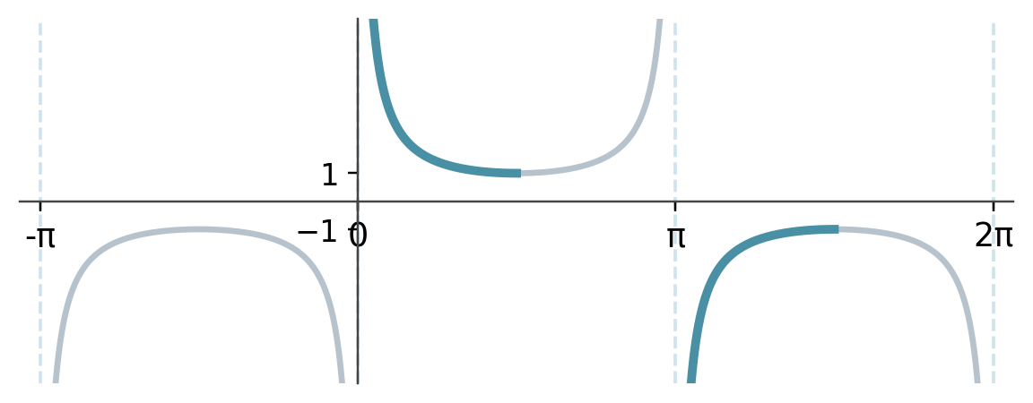
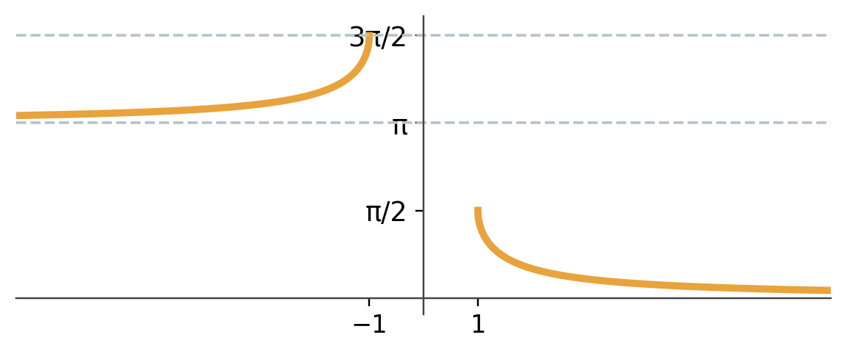
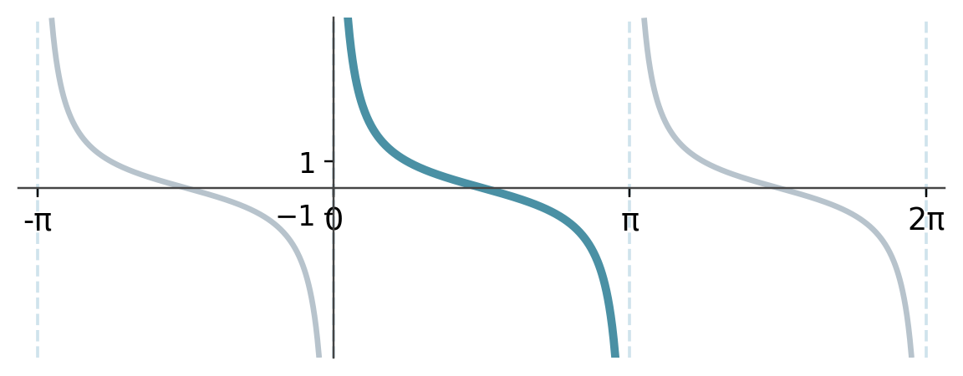
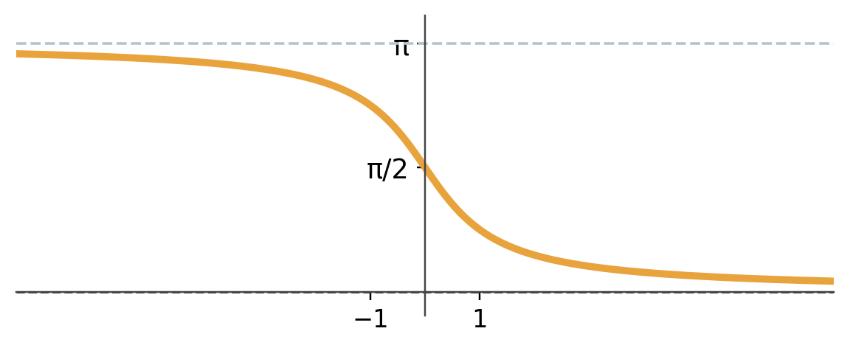
COMPLETING THE FAMILY
Inverse Secant, Cosecant & Cotangent
Each restricted function (blue → teal) is reflected across y = x to give its inverse (amber), just like sine, cosine, and tangent.
sec⁻¹x
domain: 0 ≤ x < π/2 or π ≤ x < 3π/2
csc⁻¹x
domain: 0 < x ≤ π/2 or π < x ≤ 3π/2
cot⁻¹x
domain: 0 < x < π
14

Slide 15
WRAP UP
Key Takeaways
sin⁻¹x
cos⁻¹x
tan⁻¹x
Domain
Domain
Domain
[−1, 1]
[−1, 1]
all reals ℝ
Range
Range
Range
[−π/2, π/2]
[0, π]
(−π/2, π/2)
also: arcsin
also: arccos
also: arctan
The one rule to remember
f⁻¹(f(x)) = x only when x lies inside the restricted domain used to define f⁻¹.
Outside that interval, evaluate the inside expression first, then apply the inverse function to the resulting number.
15

